Slide 1
openQA
Avoiding Disasters of Biblical Proportions
Richard Brown
rbrown@suse.com
Adam Williamson
awilliam@redhat.com

Slide 2
Plan
Elephant in the room
What could possibly bring these together?
What is openQA
Capabilities
Use by Fedora
Use by openSUSE
Futures

Slide 3
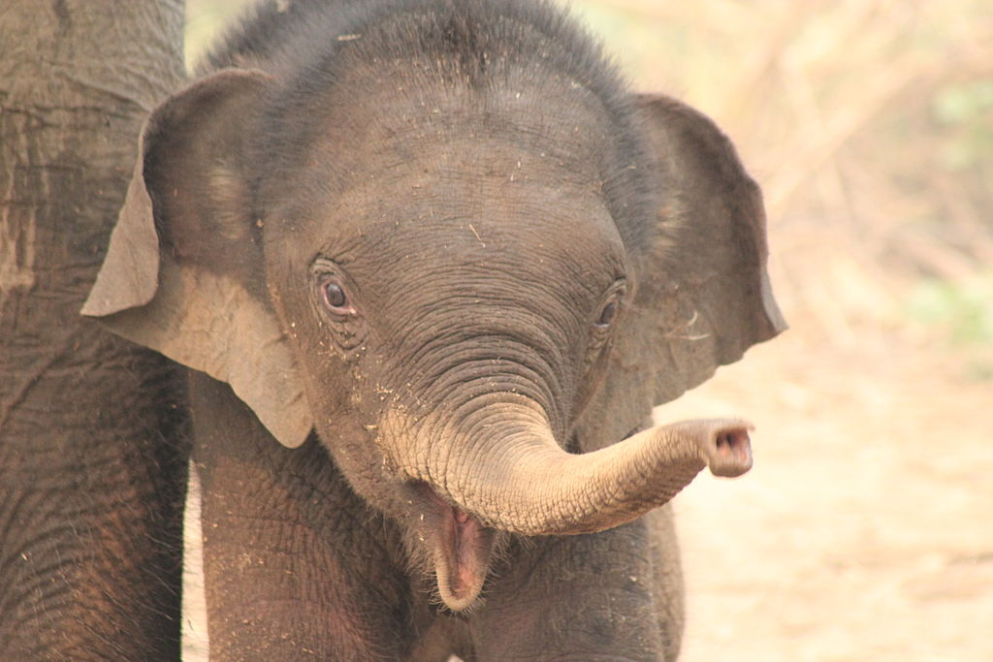
CC-BY Sophie47 @ commons.wikimedia.org

Slide 4
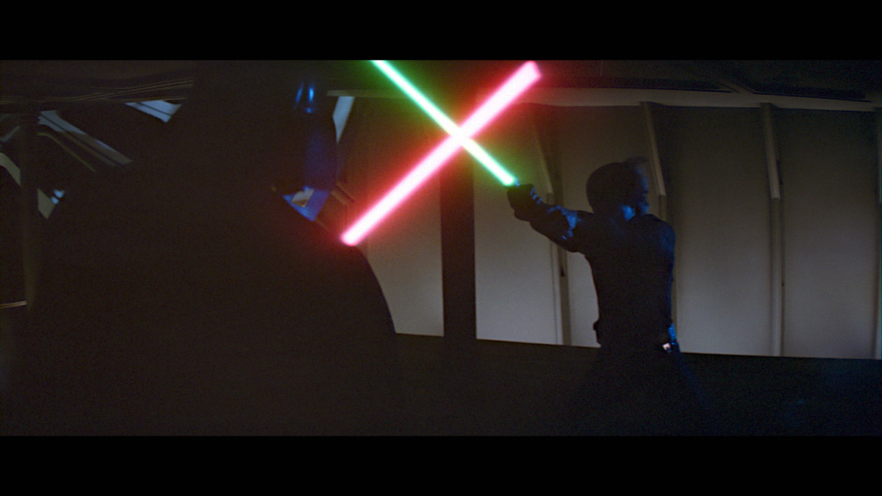
© starwars.com

Slide 5

CC-BY Lauri Kosonen @ en.wikipedia.org

Slide 6
What the ****?

Slide 7
“Testing is HARD”
- Everyone who has built any software, ever.

Slide 8
Upstreams
Upstream projects are moving fast
Kernel 4.x – New version every 3 months
GNOME 3.x – New version every 6 months
KDE Plasma 5.x – New version every 3 months

Slide 9
Users
Users expectations are trending towards receiving software faster and faster
Rolling Releases (openSUSE Tumbleweed, Arch)
OBS, Copr, PPAs, AUR

Slide 10
Diversification
Distribution Projects are offering more stuff in different ways
Editions (Fedora Workstation, Server, Cloud)
Multiple Distributions (openSUSE Leap, Tumbleweed)
Modularization, Containers, Docker, JeOS

Slide 11
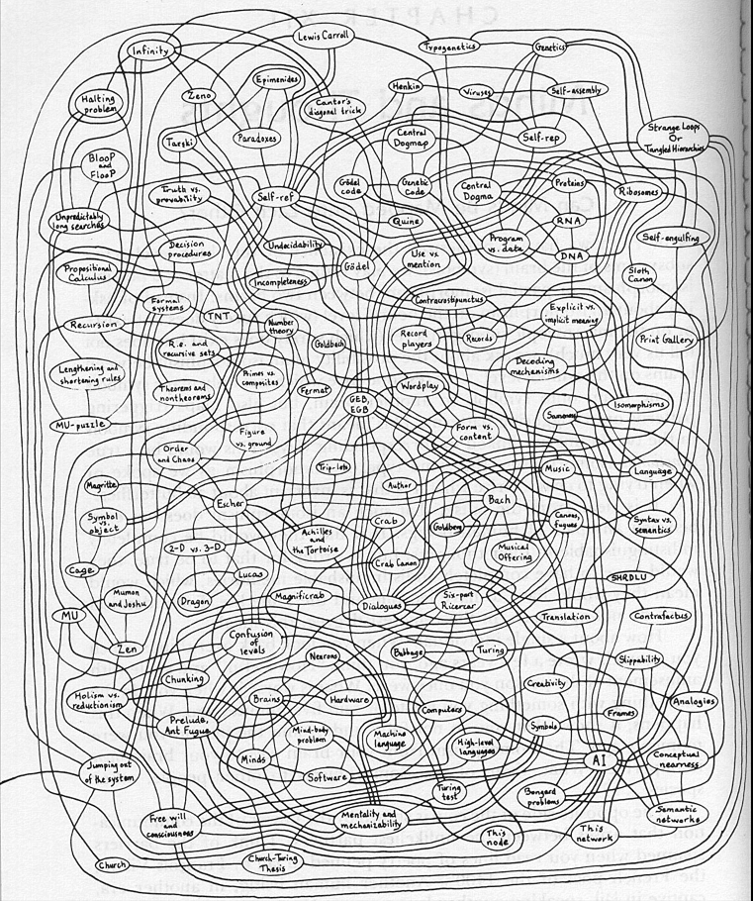

Slide 12
But..
DevOps
Containers
CI
Jenkins
Gerrit

Slide 13
But..
DevOps
Containers
CI
Docker
Jenkins
Gerrit

Slide 14
But..
Docker
DevOps
Containers
CI
Docker
Jenkins
Gerrit

Slide 15
But..
Docker
DevOps
Containers
CI
Docker
Jenkins
Gerrit
Docker

Slide 16
But..
Docker
DevOps
Docker
Containers
Docker
CI
Docker
Docker
Docker
Jenkins
Gerrit
Docker
Docker

Slide 17
NEWS FLASH: We do not write code
We build Distributions
Our users do not care if our code works, only if it works correctly as part of the Distribution
Lots of testing tools for Code, none for actual Operating Systems and Apps as a cohesive product

Slide 18
openQA to the rescue

Slide 19
openQA
Open Source distribution testing framework
Started in 2009
Tests Operating Systems and their applications
GUI & Console Testing
Used by openSUSE® Leap, Tumbleweed, SUSE® Linux Enterprise & Fedora®

Slide 20
Tests like a User
Does NOT touch the software directly
Controls keyboard & mouse and uses them like a user
Uses OpenCV to ‘read’ the actual screen output and compare to predefined needles
Also reads plain text from serial

Slide 21
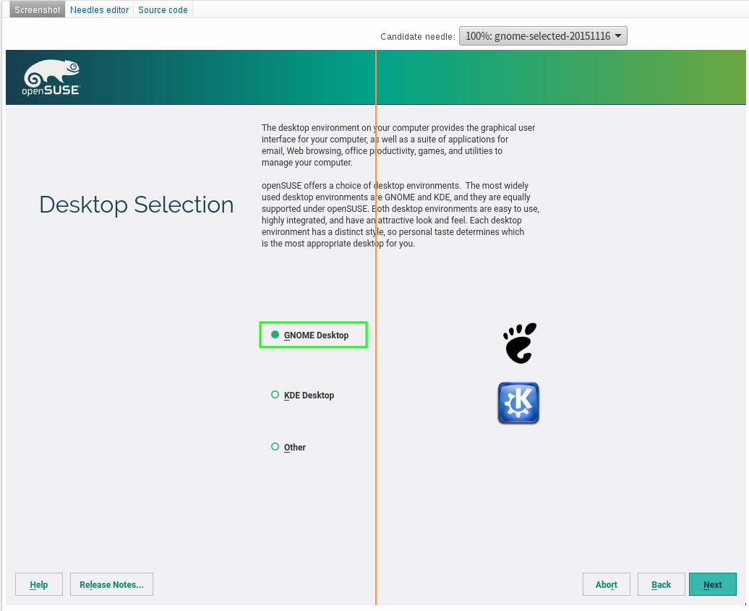

Slide 22
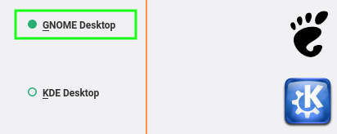
Needles only match areas of interest

Slide 23
Not just graphical testing
<< type_string(string='\'curl -f -v http://10.0.2.2:20063/current_script > /tmp/scriptrPOv.sh && echo "curl-0" > /dev/ttyS0\'', max_interval='\'250\'')
<<< wait_serial(regex='curl-0', timeout=2)
>>> wait_serial: curl-0: ok

Slide 24
Reports like a Pro
Records screenshots & logs for analysis
Encodes video of each test run
Provides ISO/HDD images for reproduction
Dashboard for easy review and reporting

Slide 25
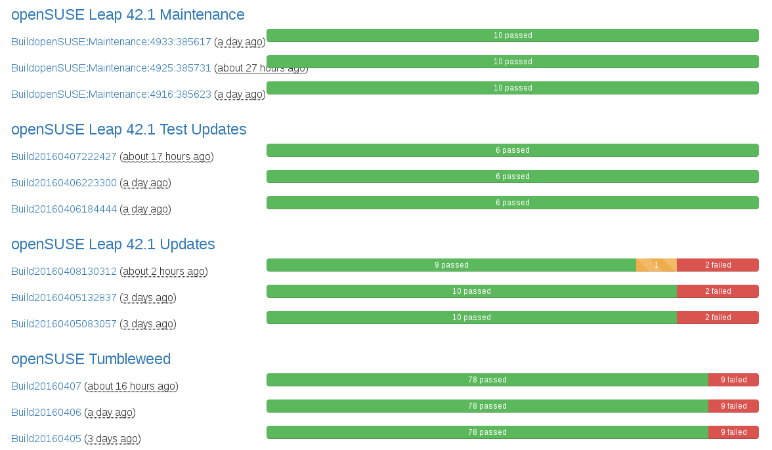
Product Dashboard

Slide 26
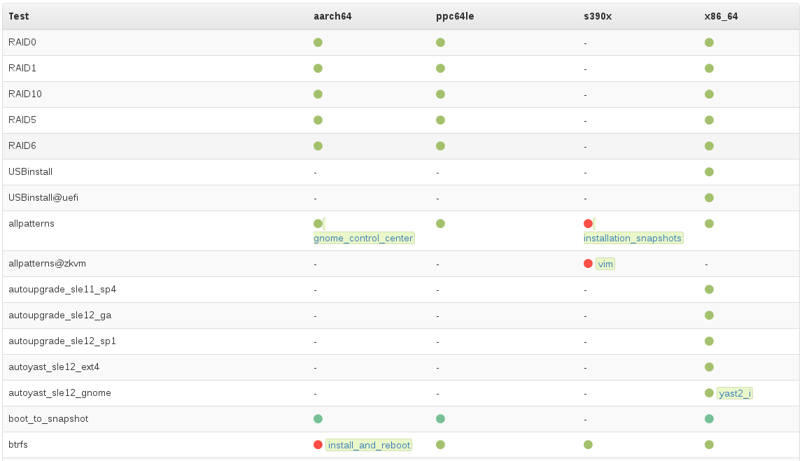
Build Dashboard

Slide 27
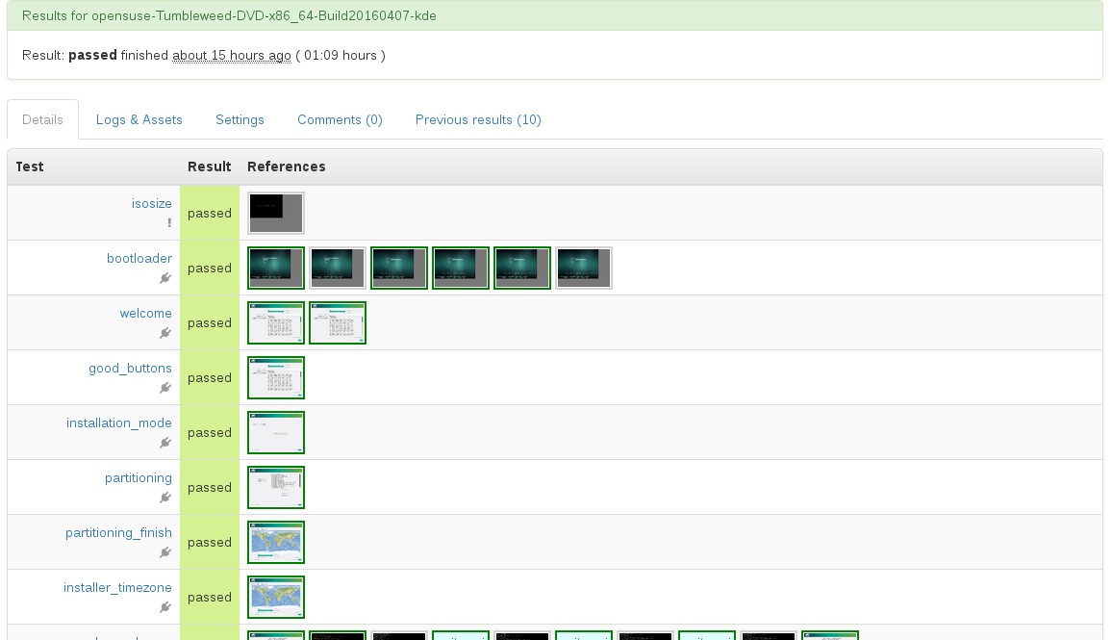
Test Results

Slide 28
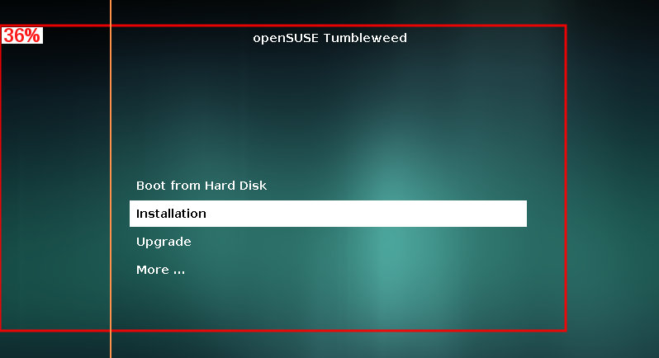
Visual Diff

Slide 29
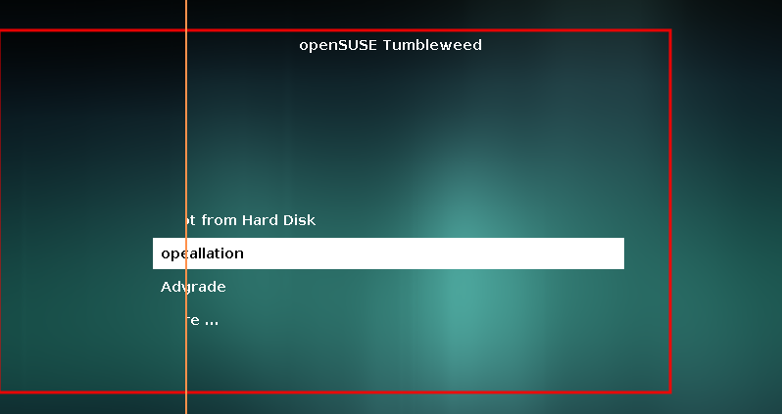
Visual Diff

Slide 30
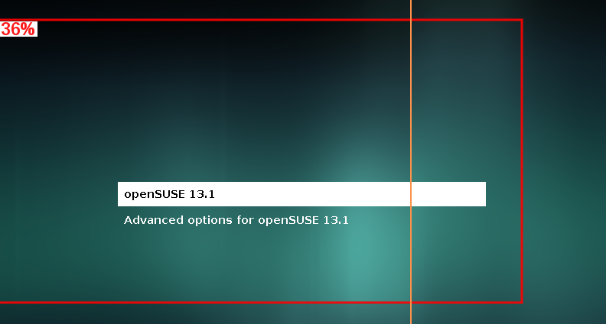
Visual Diff

Slide 31
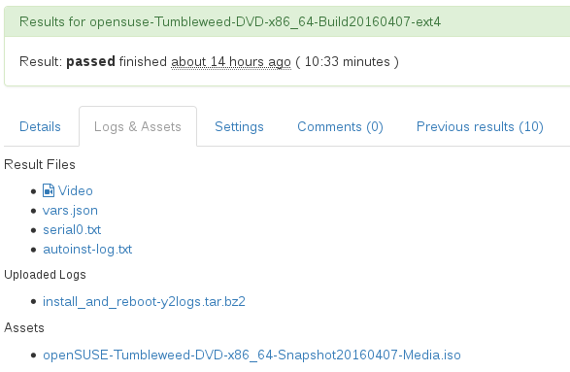
Logs & Assets

Slide 32
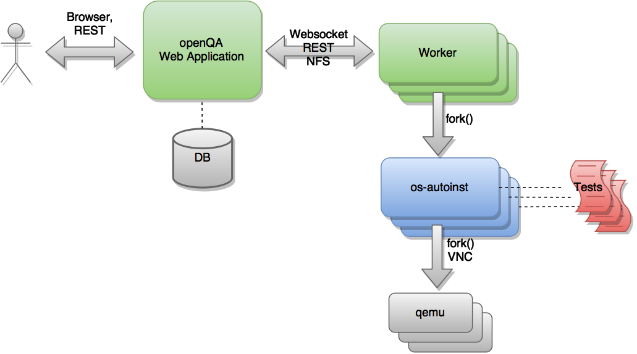
openQA Architecture

Slide 33
Feature Highlights
Multi Arch Support (Intel, ppc64le, s390x, aarch64)
FedMsg Support
Multi Machine Testing (incl. openvswitch)
Real Hardware Testing (IPMI & IP KVM)
Disk Image Creation
Testing without OS Installation (Testing from Image)

Slide 34
Fedora and openQA

Slide 35
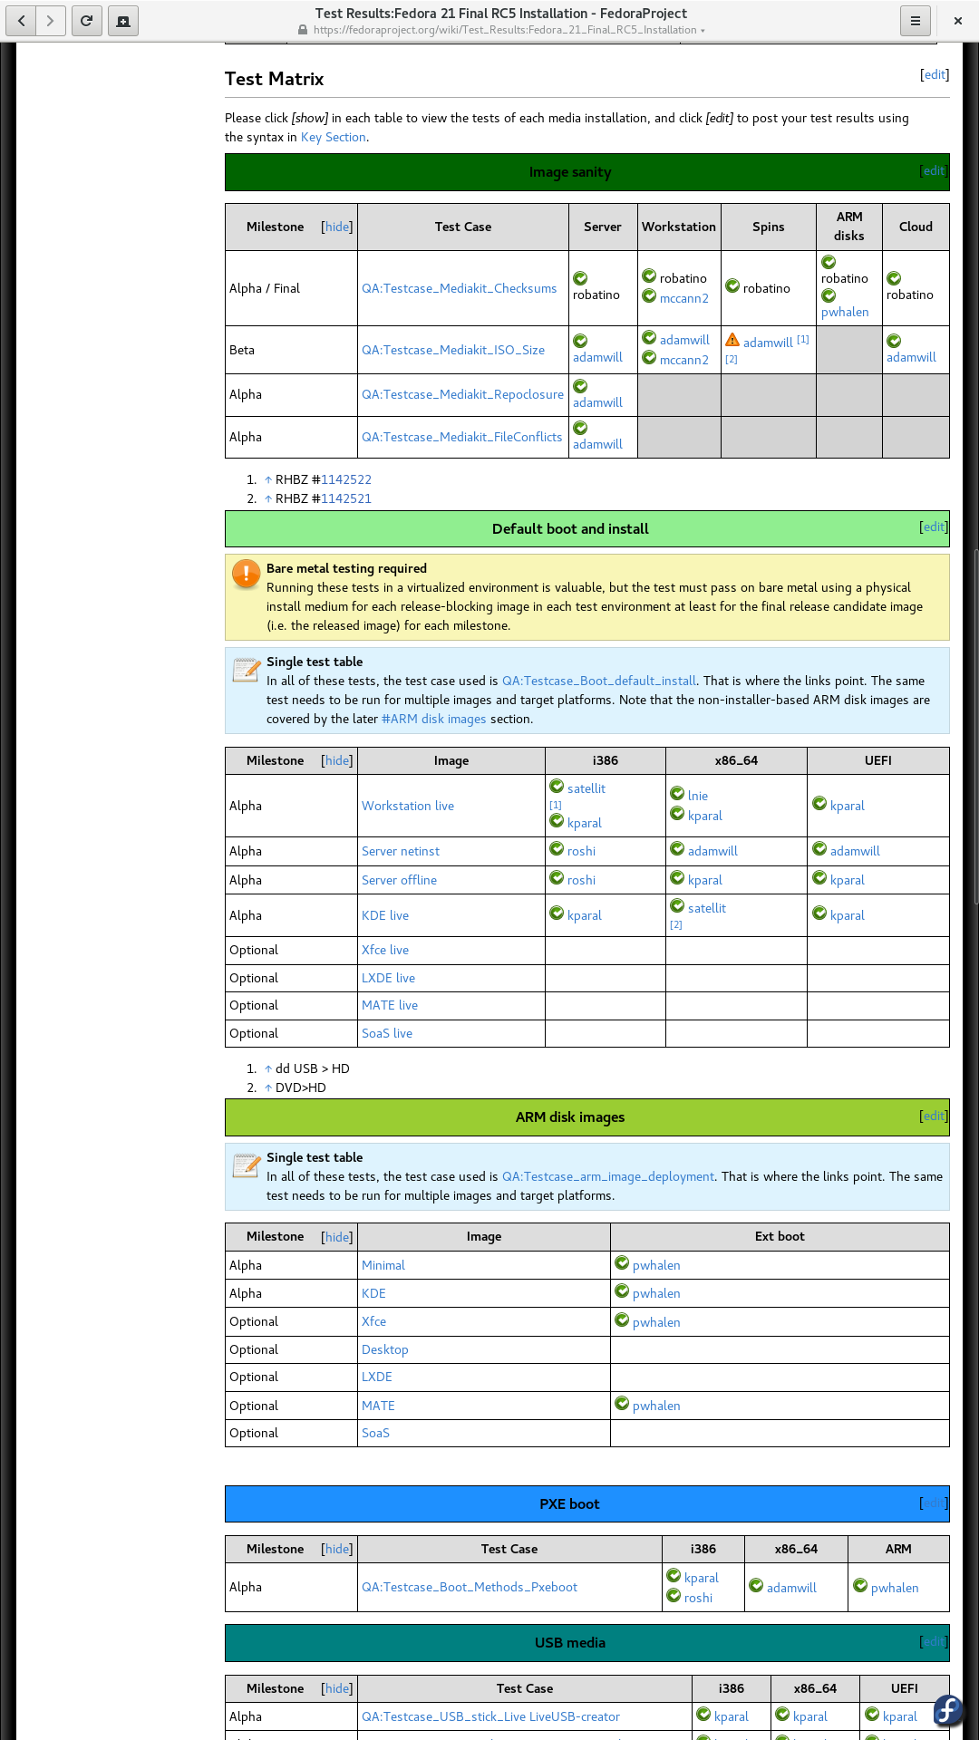
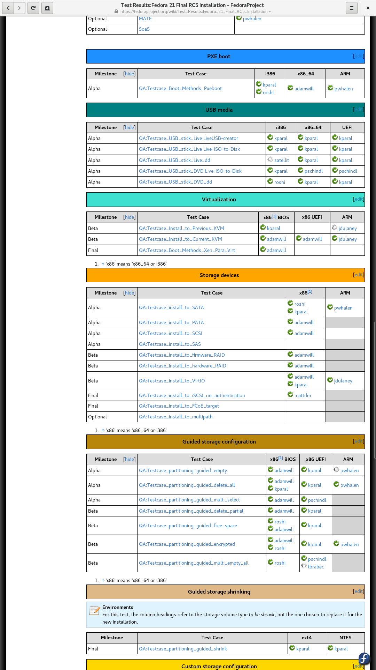
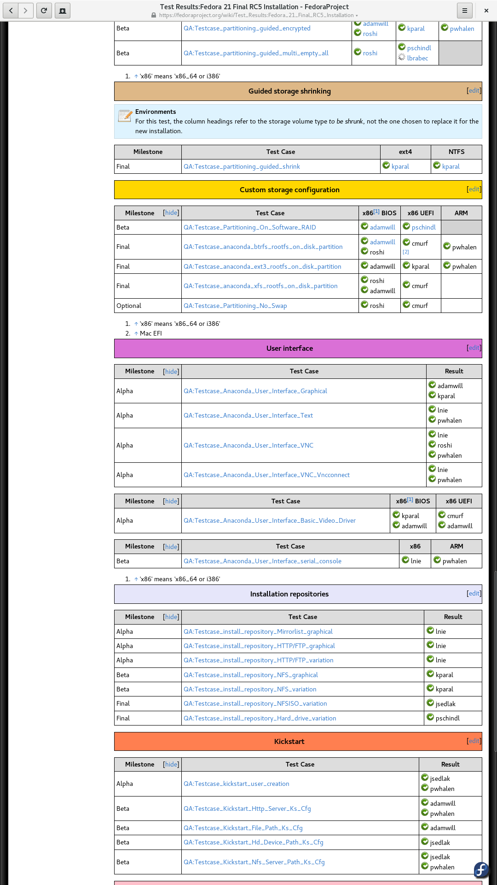
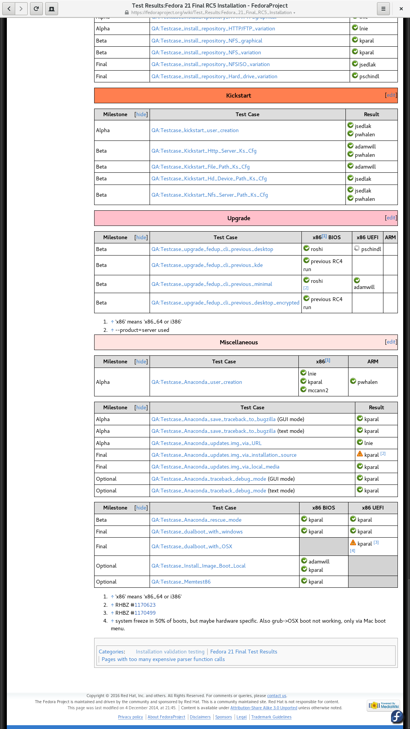
Losing my religion
Notes:
Release validation testing: all manual before January 2015
Largest of five ‘validation test matrices’
Nearly all tests required for every Final release candidate
Complete testing run takes several people 12-24 hours

Slide 36
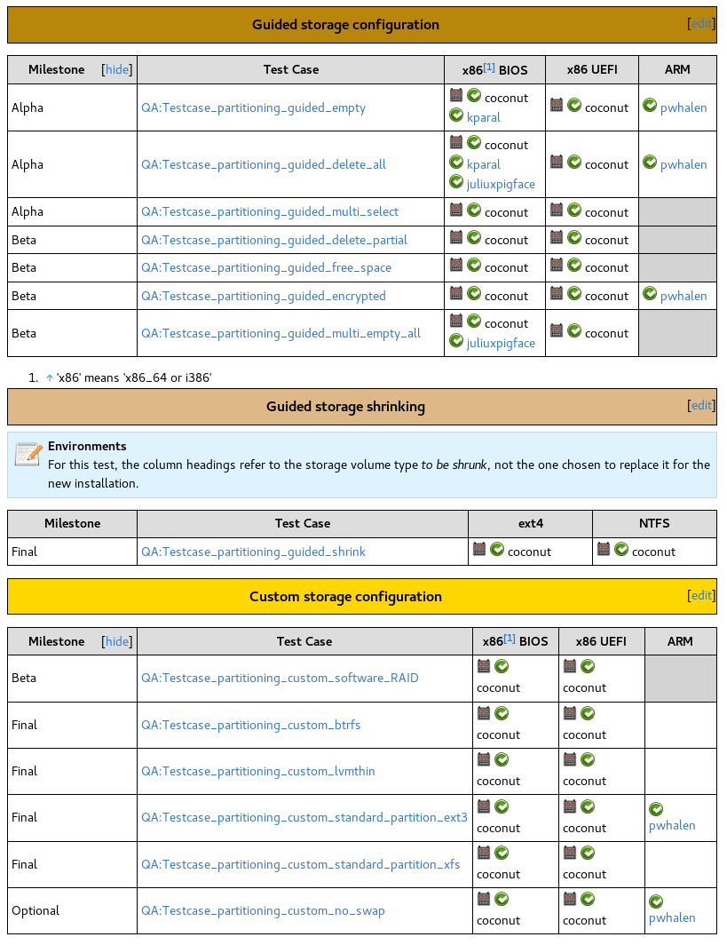
The Glorious Present
~40% validation tests automated
openQA results reported to wiki
Tests triggered automatically

Slide 37
Nightly testing
Rawhide and Branched ‘nightly’ composes tested
Email result notification
Nightly image finder
‘Gating’ plans in discussion with release engineering
Easy bug reporting (installer crashes)

Slide 38
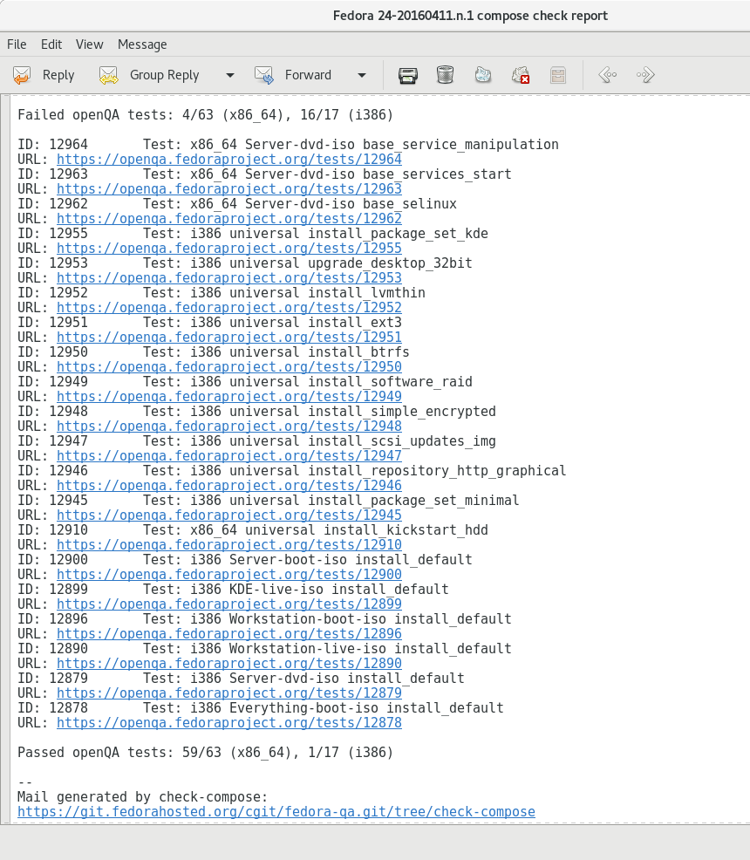
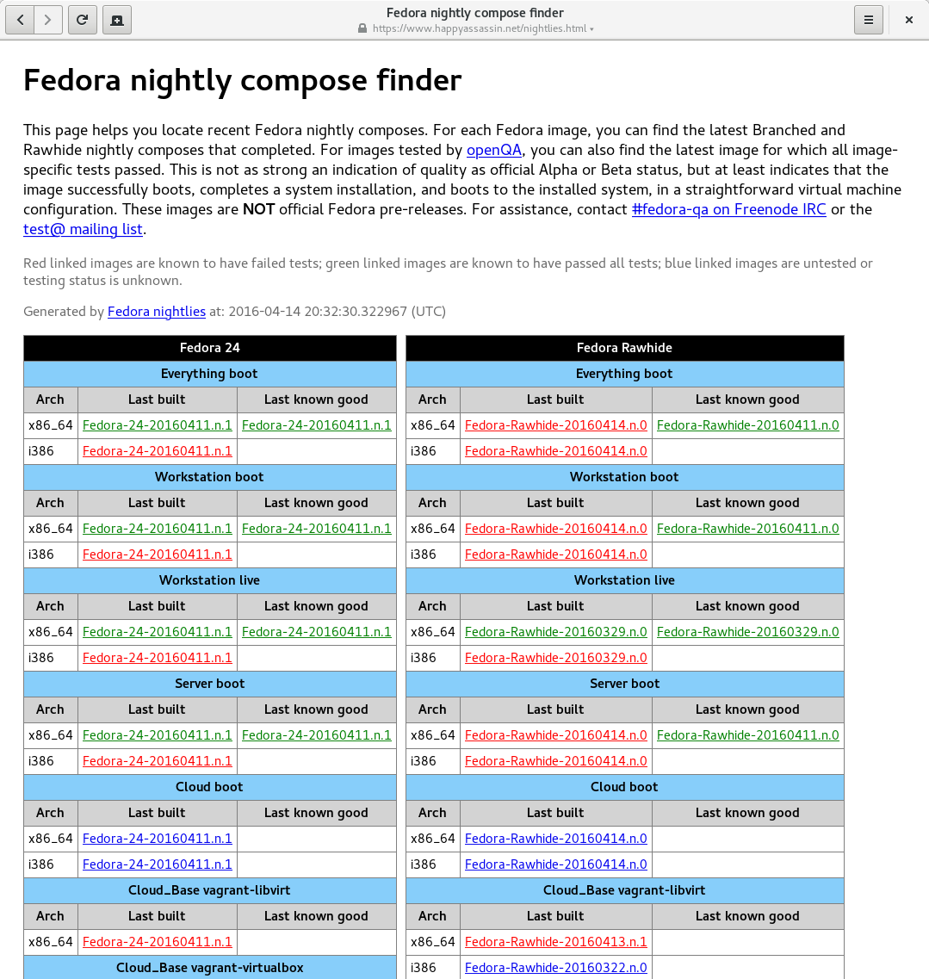
What is it good for?
Notes:
Left: ‘compose check report’ - mail generated when openQA tests complete for a compose.
Right: ‘nightly image finder’ - tracks last built and last known good (passed all image-specific tests) for Rawhide and Branched.
Both triggered by fedmsg.

Slide 39
New Directions
Testing ‘updates images’
Kickstart-tests converter
Testing installer updates
Testing as a service
Notes:
Some things we’re just starting to think about / work on.
‘updates images’ - new feature in Fedora scheduler to run tests for a given compose plus an anaconda updates image. Special ‘build’ value used to indicate use of updates image.
Kickstart-tests – anaconda’s own automated test suite / ersatz runner. Bunch of tests as kickstart files with a standard way for reporting results. We have a converter to run the tests in openQA: discussing where to go with that ATM
Installer updates – chicken/egg problem: we need to know if an image built with the update works properly in order to decide whether to release the update, but nightly builds are built from stable, we do not get image builds with the testing packages. Looking at ways to do this.
Testing as a service – along with some of the above, possibility of allowing non-QA teams (e.g. anaconda team) to trigger tests.

Slide 40
openQA in Fedora
Packaged in official repositories (F23+)
Two deployments (staging and production)
Both run on Fedora 23 in Fedora data center
Deployment completely Ansible-driven
Can be rebuilt from scratch at will
Ansible plays usable outside Fedora infra
Fedmsg-driven scheduler

Slide 41
Together in perfect harmony
Asset downloading and extraction
Fedmsg emitter
Dockerfiles
Packaging / automated deployment improvements
Searching improvements
Bug fixes
Bugs
Notes:
Stuff Fedora has contributed to openQA. Commits:
Initial ISO download
Improved asset downloading
Asset extraction
Fedmsg emitter
Dockerfiles introduction
Admin user and API key creation script
generate-packed-assets script (reduced packaging complexity)
Search by job ID
Search by HDD_1
Great collaborative development experience with SUSE / Fedora devs reviewing and contributing to each other’s changes.
Dat favicon tho

Slide 42
openSUSE and openQA

Slide 43


2 Codebases – 1 Distribution
SUSE® Linux
Enterprise

Slide 44
openSUSE Leap
openSUSE Leap is a new distribution combining packages from both SUSE Linux Enterprise and openSUSE
Extensive integration challenge, combining two separate code bases and ensuring key functionality is preserved
Dozens of different installation/upgrade scenarios tested for each development build

Slide 45

ALWAYS CHANGING.. ALWAYS WORKING

Slide 46
openSUSE Tumbleweed
Tumbleweed is openSUSE's rolling release
openQA is an integral part of Tumbleweed development
In depth testing is then carried out on the whole distribution before release
openSUSE Tumbleweed snapshots released after successful testing
New Tumbleweed release every 2-3 days, often faster.

Slide 47
A 'quiet' Tumbleweek
3 Snapshots
146 Package Updates
15 New Packages on the DVD
38 Packages Removed from the DVD
1 new Kernel
All tested with over 118 different installations/upgrades

Slide 48
A 'quiet' Tumbleweek
3 Snapshots
146 Package Updates
15 New Packages on the DVD
38 Packages Removed from the DVD
1 new Kernel
All tested with over 118 different installations/upgrades
QUIET?!

Slide 49
Tumbleweek 31/03 – 7/04 2016
5 Snapshots
370 package updates
2 new Kernels
GNOME 3.20 a week after it’s upstream release
All tested with over 118 different installations and upgrades

Slide 50

openQA & SUSE Linux Enterprise
Package
Submission
“Staging”
Build
Validation
Milestone
openQA
Alpha/Beta/RC
“Post-Validation”
Product

Slide 51
All tested by openQA
>8000 Packages
Community Developed
Rolling Updates
Over 6000 Packages
Community Developed
SUSE® Linux Enterprise
Shared Core
Enterprise Packages
SUSE Developed
Rolling Base System
Stable Base System
Regular Updates

Slide 52
Futures

Slide 53
Currently being baked..
Libvirt backend (KVM, Xen, Vmware, KVM for systemZ)
Improved IMPI backend (SuperMicro, Dell iDRAC, etc)
New Review Workflow
  Tag issues with comments or bug ID’s
  Tags appear next to scenario traffic lights on dashboard
  Repeated issues automatically inherit previous Tags
Build Tagging
  Mark a build as important to ensure result & asset retention
  Tagged builds can be immune from ‘obsolescence’

Slide 54
Whatever you want..or build!
Main Website
  http://os-autoinst.github.io/openQA
Documentation
  http://os-autoinst.github.io/openQA/documentation/
Bug Reports & Feature Requests
  https://progress.opensuse.org/projects/openqav3

Slide 55
Questions?

Slide 56
Want to learn more?
os-autoinst.github.io/openQA
Text goes here

Slide 58
License
This slide deck is licensed under the Creative Commons Attribution-ShareAlike 4.0 International license. It can be shared and adapted for any purpose (even commercially) as long as Attribution is given and any derivative work is distributed under the same license.
Details can be found at https://creativecommons.org/licenses/by-sa/4.0/
Credits
Template
Richard Brown
rbrown@opensuse.org
Design & Inspiration
openSUSE Design Team
http://opensuse.github.io/branding-guidelines/

